Slide 1



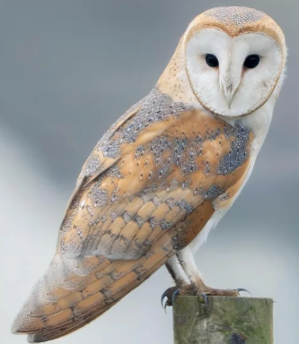
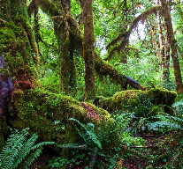

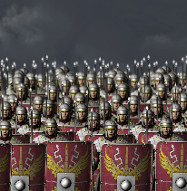
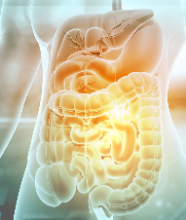

Maths
The children will secure knowledge of numbers within 1,000 and work with numbers up to 10,000. Add and subtract numbers
with up to 3-digit/4-digits and
exchange digits when needed.
Multiply and divide by 10 and 100.
Learn multiplication and division
facts. They will also calculate the
area of rectilinear shapes, make their
own shapes and then compare and
order the different areas.
Barn Owl Class
Year 3/4
English
The children's writing for purpose, will
be to inform, persuade and to entertain.
They will be doing this through speech
and letters, a non-chronological
report, a short story and poetry.
Skills developed will include: Noun
phrases, conjunctions, adverbs, pronouns, fronted adverbials, and use of inverted commas. They will also learn to proof-read for spelling and punctuation errors.
History
The children will investigate life in Ancient Rome and explore the causes of the Roman invasion
of Britain.
Science
The children will be learning 2 units this term, Light and shadows. They will explore the role of light sources and investigate shadows. Also, Animals including humans: Digestion and food.
Geography
The children will lean about why rainforests are important to us..

Slide 2
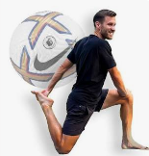
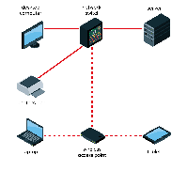
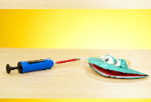
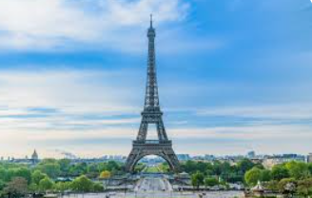
Computing
The children will develop an understanding of computer networks by learning how devices communicate and share information.
PSHE
The children will be looking at two units: Me and my relationships and Valuing differences.
Music
Children will develop their singing technique. Learning to keep in time and work on musical notation and rhythm.
PE
The children will be doing Fitness, Football, Yoga and Dance.
Home learning
Reading- at least 10 minutes daily.
Times tables- TT Rockstars daily.
English-15-20 mins - given out on Tuesday and due in the following Monday
Maths – 15 -20mins - given out on a Tuesday and due in the following Monday
Spellings- Practise the weekly words to be tested on a Monday.
DT
The children learn about mechanical systems: Pneumatic toys and the Digital World: wearable technology.
Art
The children will develop drawing skills through observation, tone, texture and proportion.
French
The children practise a variety of greetings and learn how to introduce themselves.. Also use adjectives of colour and size to describe shapes.
Worldviews
The children will learn – What makes us human? And why is water symbolic?

