Slide 1
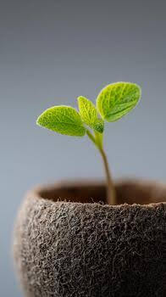


Maths
The children will be learning about place value, addition and subtraction, and shape.
https://whiteroseeducation.com/parent-pupil-resources/maths
Geography
In Geography, we are learning about our local area and how to use maps. We will identify physical and human features, use simple directions, recognise landmarks from photographs, and create our own maps of the school and local area.
Hedgehogs Class
Reception
English
In writing, we will be writing mini books all about ourselves and about special people. We will learn how to use phonics knowledge to write words and use finger spaces and capital letters.
Science
The children will have two units in the Autumn Term. Introduction to plants and Seasonal changes.

Slide 2

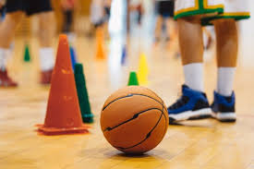
PSHE
The children will be looking at two units:
Me and my relationships
Valuing difference.
Computing
The children will learn how to use computers including logging in, using programs and saving work.
Art
In art we will be exploring different materials and techniques to develop our creative ideas. We will use sketchbooks to plan and record our work, practise drawing from observation, and talk about our own and others’ artwork.
History
In History, we are learning about the past by looking at photographs, objects and stories. We will explore events in our own lives, create simple timelines, and talk about what has changed and what has stayed the same.
PE
The children will develop their skills through fitness, team building, yoga, ball skills and fudamentals.
Music
In Music, we are developing our musical skills by keeping a steady pulse through movement, singing and playing instruments. We will listen and respond to different pieces of music, learn songs and rhymes, and explore changes in tempo.
RE
The children will have two units in the Autumn Term:
What do some people believe God looks like?
How did the world begin?

