Slide 1
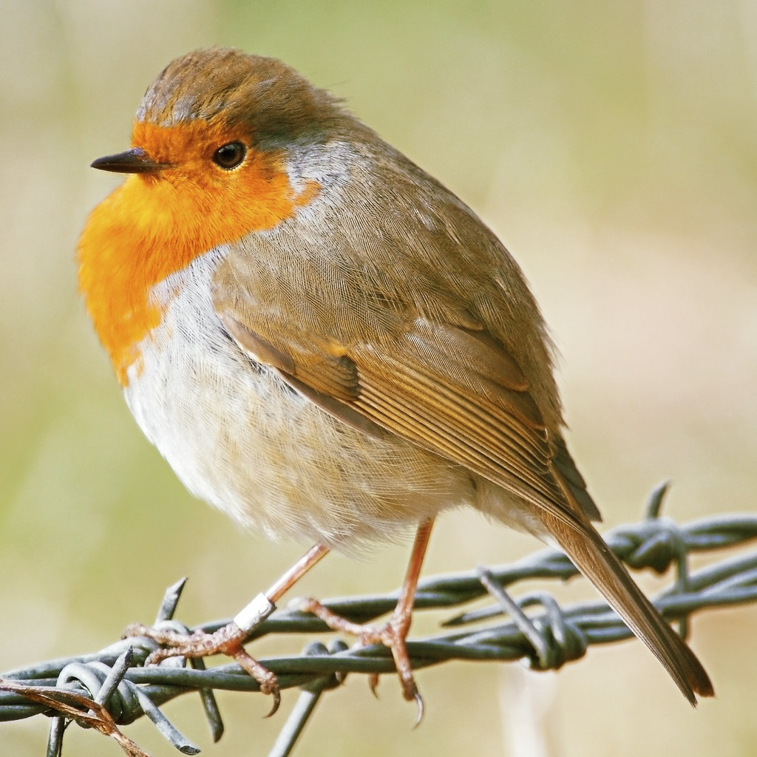

Maths
Number and Numerical Patterns
Children will build on their early number experiences by developing their counting and subitising skills (recognising quantities without counting). They will explore numbers to 5, learning how numbers can be made in different ways and beginning to compare groups of objects using mathematical language. Children will also identify smaller numbers within larger numbers and explain what they notice about different number arrangements.
Robins
Reception Class
English
Children will explore a range of stories and information books, learning how words and pictures work together to help us understand texts. They will talk about characters, settings and events, share their favourite books, and develop their own ideas through speaking, role play, drawing and writing. As their phonics knowledge grows, children will begin to write sounds, words and simple sentences, creating their own stories and information texts to share with others..
Phonics
Children will consolidate their Phase 1 phonics skills before beginning Phase 2. They will learn new letter sounds, practise recognising and forming letters, and begin blending sounds to read simple words. They will also learn a range of tricky words and apply their phonics knowledge through reading, writing, games, and practical activities. Regular assessment and review will support children's progress and confidence as early readers and writers.

Slide 2

Understanding the World
Children will explore their own lives and experiences by learning about how they have changed over time, the people who make up their family, and the place where they live in the world. They will also investigate their five senses, discovering how they use them to learn about and understand the world around them.
Expressive Art and Design
Children will explore colour through a range of creative activities, learning to identify, mix and use different colours in their artwork. They will also develop their designing and making skills by creating a special memory box, using a variety of materials and techniques to represent important people, places and memories.
Music
Children will explore different sounds using their voices, bodies and a range of musical instruments. They will experiment with changing the speed (tempo) and volume (dynamics) of sounds, listen carefully to identify sounds in the environment, and begin to express themselves creatively through music and movement.
PE
Children will learn how to move safely and confidently in a shared space, developing control, balance and coordination through a range of activities. They will practise different ways of travelling, use equipment safely, follow simple instructions and pathways, and work cooperatively with others through partner and group games. Children will also develop their ability to lead, follow and copy movements, building confidence and teamwork skills.

Slide 3
Personal, Social, Emotional Development
Children will learn to recognise their importance within the class community and develop positive friendships through kindness, cooperation and respect. They will build confidence and independence by managing their own needs, such as dressing themselves and looking after personal hygiene. Children will also learn to identify and talk about emotions, set simple goals, persevere when faced with challenges, and develop resilience as they try new activities and experiences.
Physical Development
Children will develop their physical skills through everyday routines and practical activities. They will learn to move safely around school, sit appropriately for learning, and develop good pencil control using a tripod grip. Through a range of activities, children will strengthen their fine motor skills and gain confidence using tools such as pencils, paintbrushes, scissors, and cutlery safely and effectively.
Communication and Language
Children will develop their listening and speaking skills by learning why listening carefully is important and following instructions during daily routines. They will build their vocabulary through class topics and everyday experiences, use polite social phrases when talking to others, and take part in whole-class and small-group discussions. Children will also learn to ask and answer questions to deepen their understanding, share their ideas and experiences, and become confident communicators.

