Slide 1
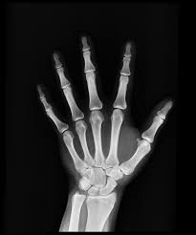
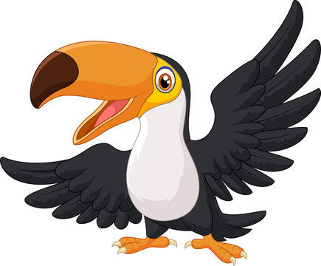
History
The children will be exploring the question-Would you prefer to have lived in the Stone Age, Bronze Age or Iron Age?
.
Maths
The units the children will be looking at this half term are place value and addition and subtraction. We will continue to work on our times table fluency in preparation for Year 4.
Year 3
English
The children’s writing will focus on learning about narratives and poetry. Our focus texts will be ‘Mini Rabbit not lost’ by John Bond and poetry ‘Words are Ours’ by Michael Rosen and ‘The Magic Box’ by Kit Wright.
Science
In the Autumn term children will learn all about the role of a skeleton and muscles, how the body uses energy and what constitutes a balanced diet.

Slide 2
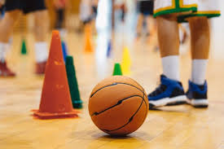

PSHE
The unit the children will be looking at is ‘Me and my relationships’.
Computing
The children will be exploring programming. They will be exploring creating their own coding and debugging using scratch.
Art
The children will be developing shading skills and drawing techniques to create botanical inspired digital drawings.
French
We will be learning French greetings including day and night and asking how people are feeling.
PE
The children will be doing fitness and ball skills.
Home learning
Reading- at least 10 minutes daily.
Times tables- TT Rockstars daily.
Worldviews
The children will explore spirituality, the inner self and the soul through different religious and non-religious worldviews.
Music
In the spring term, develop their music skills through listening and singing. Our unit is called Mountain Melodies : Steps and leaps.

