Slide 1
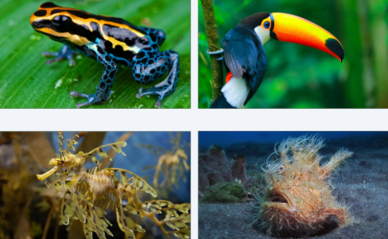
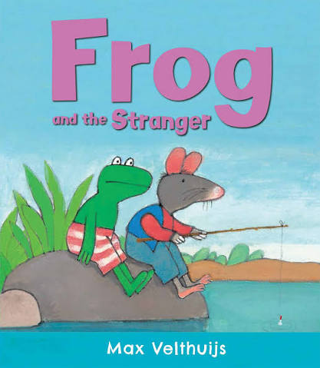

Maths
The units the children will be looking at are place value, addition and subtraction and shape.
Geography
Would you prefer to live in a hot or cold place?
During this learning, the children will examine climate zones, locate hot and cold places around the world and compare different climates, learning the names and locations of the seven continents along the way.
Kestrels
Year 2 Class
English
The children will cover a range of genres of writing in their English lessons. Including writing narratives, instructions, list poems and letters. We will be looking at several exciting texts this term such as Frog and The Stranger, How to Make Friends with a Ghost and some poetry. After half term we will enjoy reading Last Stop on Market Street and Dragon Post to help us with our writing.
Science
The children will have two units in the Autumn term. Living Things: Habitats before half term and Living Things: Microhabitats after half term.

Slide 2
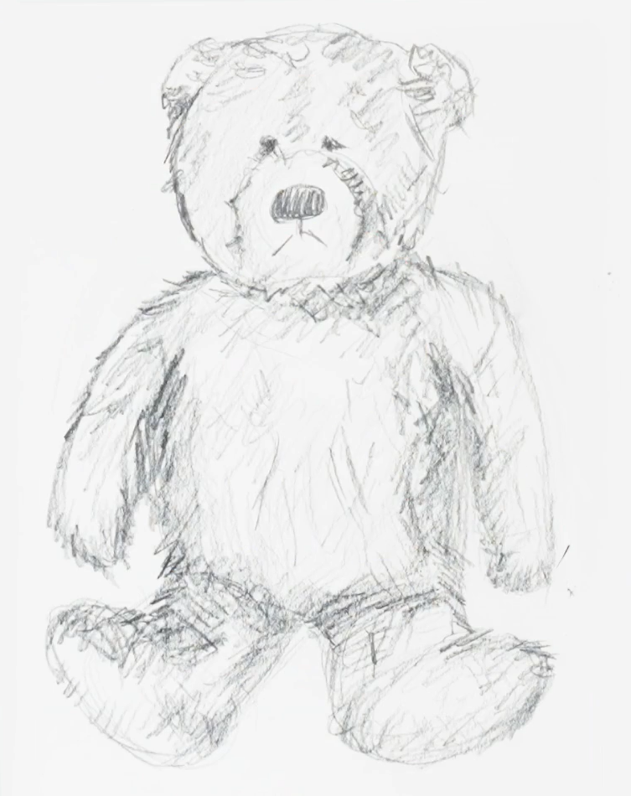
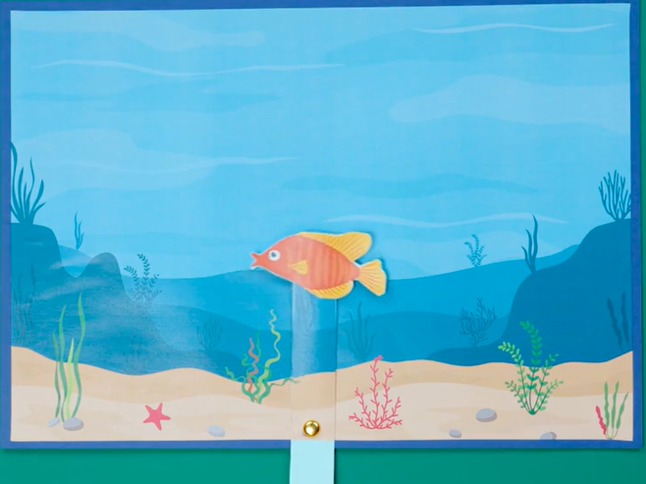

PSHE
The children will be looking at two units: My and My Relationships and Valuing Difference
Computing
During the first term children will consider the question “What is a computer?” and begin to understand what algorithms are.
Art
The children will learn about drawing using tone and texture. Children will draw using different materials, experimenting with light and dark.
PE
The children will be doing team building, fitness, fundamentals and ball skills.
DT
After half term, children will learn about mechanisms. Looking at levers used in everyday objects.
Home learning
Reading- at least 10 minutes daily.
Spellings, Maths and English homework set weekly.
Music
In the Autumn term children will follow two units of learning in music. Animals, which looks at call and response skills and Musical Storytelling, where the children will enjoy playing a range of instruments.
RE
The children will have two units in the Autumn term:
Why do we need to give thanks?
Why is light important to people?
During both units children will learn about differing beliefs and customs, including festivals and offerings.

