Slide 1
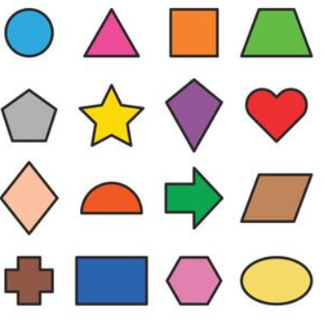

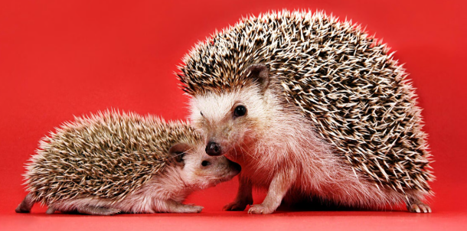

Maths
The children will be learning about place value, addition and subtraction, and shape.
https://whiteroseeducation.com/parent-pupil-resources/maths
Geography
In Geography, we are learning about our local area and how to use maps. We will use photos to look at landmarks and name features we see.
Hedgehogs Class
Reception
PSHE
The children will be looking at two units:
Me and my relationships
Valuing difference.
English
In writing, we will be writing mini books all about ourselves and about special people. We will learn how to use phonics knowledge to write words and use finger spaces and capital letters.
Science
The children will have two units in the Autumn Term. Our beautiful planets and I am a scientist.

Slide 2

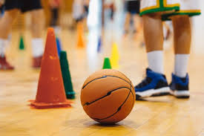
PSHE
The children will be looking at two units:
Me and my relationships
Valuing difference.
Computing
The children will be learning about online safety and parts of a computer.
Art and DT
In art we will be exploring mark making with different materials. In DT, we will be using junk modelling to create sculptures.
History
In History, we are learning about the past by looking at photographs, objects and stories. We will explore events in our own lives, create simple timelines, and talk about what has changed and what has stayed the same.
PE
The children will develop their skills through fitness, team building, yoga, ball skills and fundamentals.
Music
In Music, we are developing our musical skills by keeping a steady pulse through movement, singing and playing instruments. We will listen and respond to different pieces of music, learn songs and rhymes, and explore changes in tempo.
RE
The children will have two units in the Autumn Term:
What makes us special?
What are special times?

