Slide 1
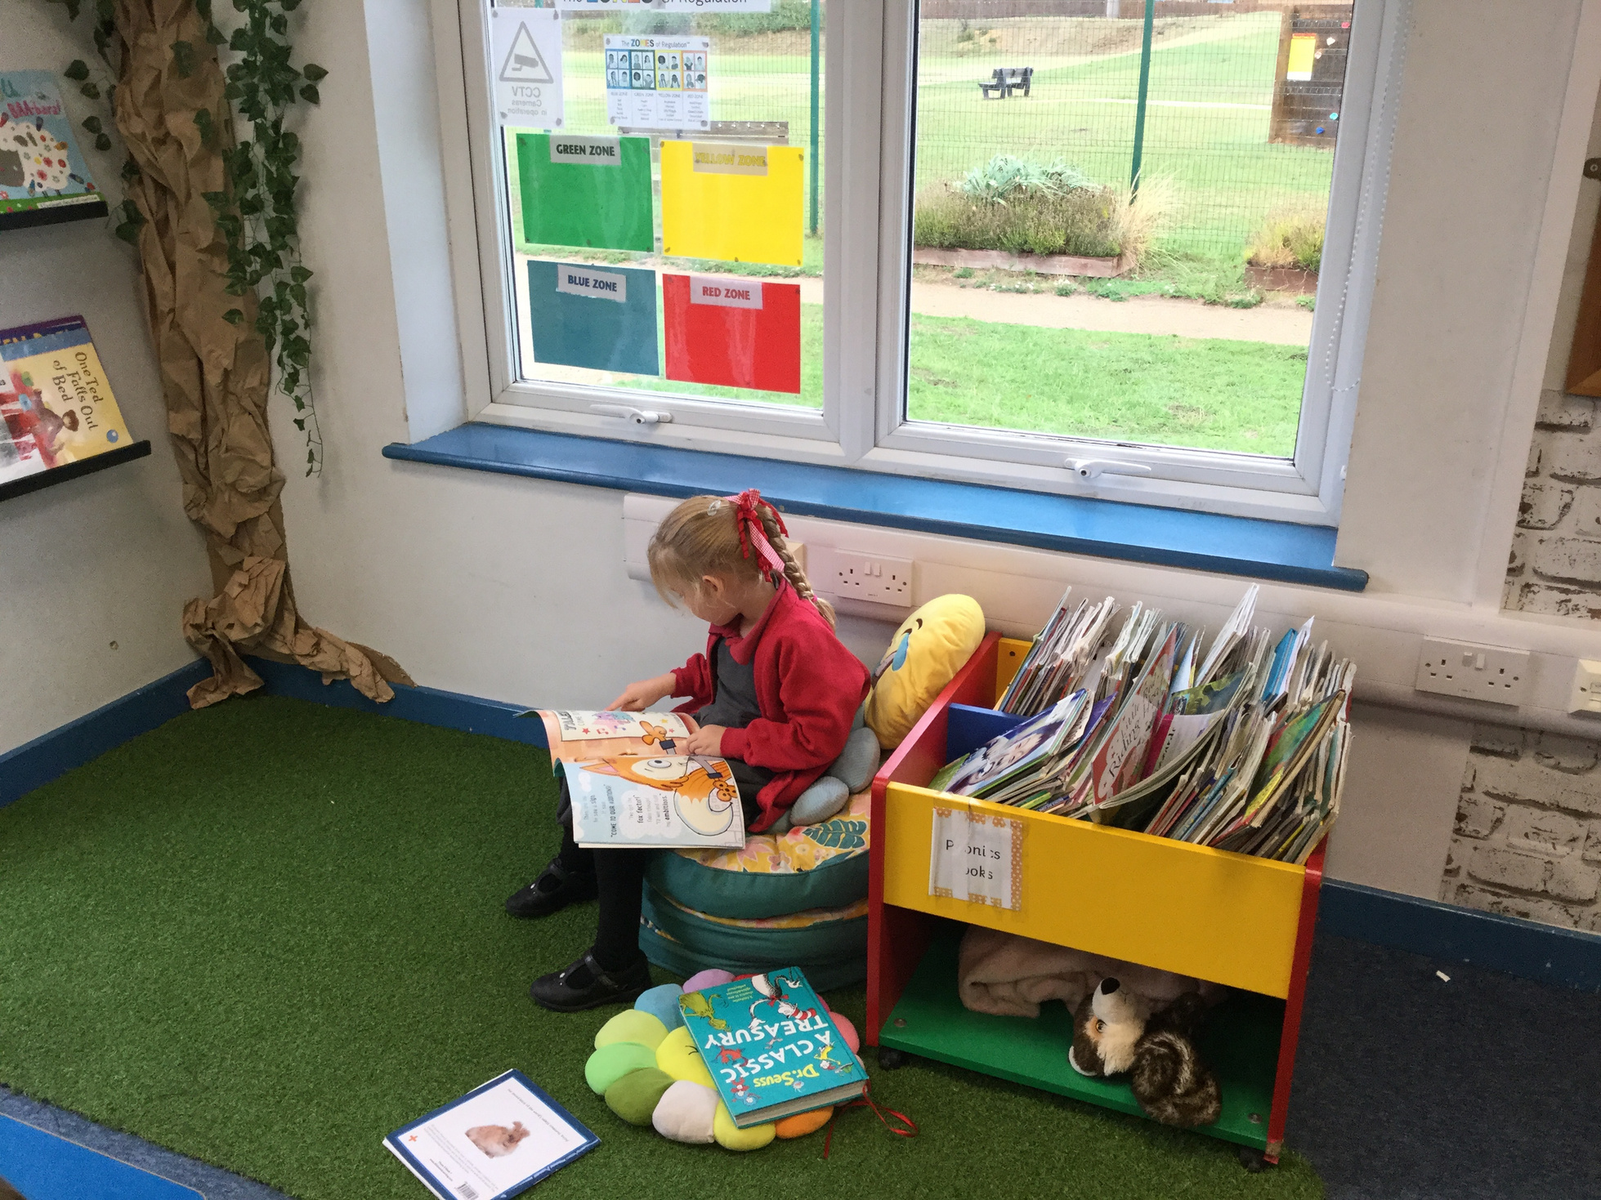

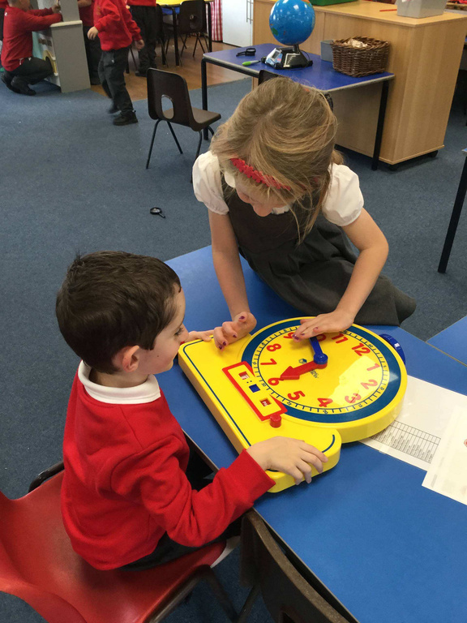
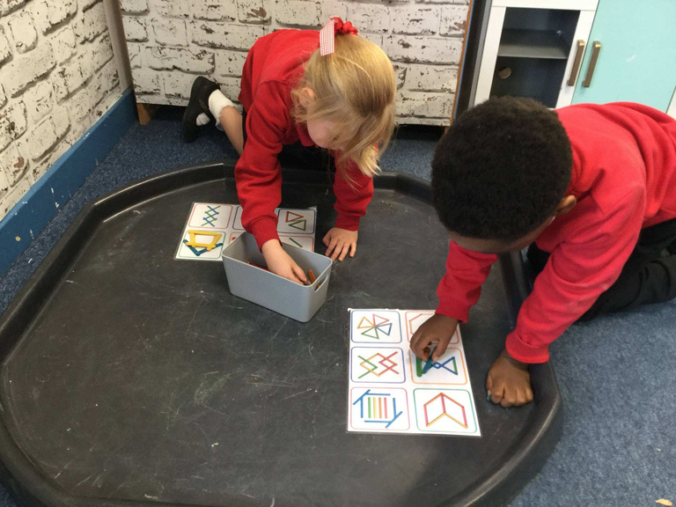
OPEN DAY
Come and take a tour of our school, meet our staff and see our school in action!
Tuesday 3rd November
2pm
Thursday 5th November
9.45am
Book your place:
Email: office@stondonlower.co.uk
Contact number:
01462 850288

