Slide 1



Maths
The units the children will be looking at are place value and addition and subtraction (within 10).
https://whiteroseeducation.com/parent-pupil-resources/maths
Geography
Children will learn to use maps, atlases and directional language to locate and describe places and features. They will explore their school and local area, identifying human and physical features through walks and aerial photographs. They will also create simple maps using pictures, colours and symbols.
Puffins
Year 1 Class
English
The children’s writing
Will be based on the
books Jasper’s Beanstalk and Puffin Peter. They will write their own instructions for planting and caring for seeds, using capital letters, finger spaces and full stops. Children will create their own ending to Puffin Peter based on their ideas, adding illustrations and speech bubbles.
Science
The children will explore how seasonal changes affect trees, weather patterns and daylight hours.

Slide 2

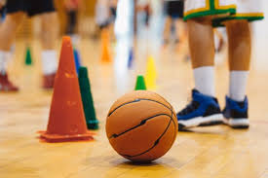

Computing
The children will be developing mouse skills by learning how to log in and navigate around a computer while creating digital artwork.
DT
Children will be investigating stable shapes and using an understanding of balance to discover how wide or heavy bases improve stability in freestanding structures.
PE
The children will be doing team building and fundamental skills.
PSHE
The unit the children will be looking at is: Me and My Relationships.
Home learning
Reading- at least 10 minutes daily.
Music
The children will be learning how to keep a steady pulse, pupils take part in music and movement activities inspired by their favourite things.
World View
We will be exploring a range of creation stories in imaginative ways, children present their own ideas using art and language.

