Slide 1



Parent Consultation on Relationships Sex Education (RSE)
Shillington & Stondon Federation
From September 2020, and no later than the summer term 2021 for those that have yet to meet their statutory requirements, it is compulsory for primary schools to teach Relationships Education and Health Education and are strongly encouraged to teach Sex Education by the Department for Education (DfE).

Slide 2
What is Relationships Education?
Relationships Education in primary schools should teach the fundamental building blocks and characteristics of positive relationships, with particular reference to friendships, family relationships, and relationships with other peers and adults.
We believe that children should learn about relationships as well as the emotional, social and physical aspects of growing up, human sexuality and sexual health, in an age-appropriate way. This goes beyond learning about relationships, to include puberty, how a baby is conceived and born, body ownership, and safeguarding.
Relationship Education also includes elements of Health Education as well as non-statutory sex education. Therefore it is often referred as RSE: Relationships and Sex Education.

Slide 3
Relationships and Sex Education helps children and young people to be safe, healthy and happy as they grow, and in their future lives.
Some aspects are taught in science, and others are taught as part of personal, social, health and economic education (PSHE).
A comprehensive programme of RSE provides accurate information about the body, reproduction, sex, and sexual health. It also gives children and young people essential skills for building positive, enjoyable, respectful and non-exploitative relationships and staying safe both on and offline.

Slide 4
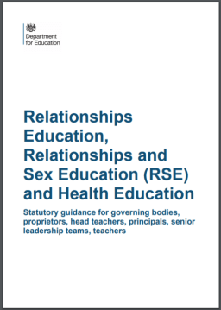
Why is the Curriculum changing?
We want all children to grow up healthy, happy, safe, and able to manage the challenges and opportunities of modern Britain. That is why, from September 2020, all primary age children will be taught Relationships and Health Education.
These subjects are designed to equip your child with knowledge to make informed decisions about their wellbeing, health and relationships as well as preparing them for a successful adult life. The world for all young people looks very different from the way it did 20 years ago when this curriculum was last updated - these changes bring the content into the 21st century, so that it is relevant for your child.

Slide 5
Contrary to popular belief teaching children RSE DOES NOT:
Encourage early sexual experimentation.
Evidence suggests that high-quality RSE does the opposite: it actually delays young people’s first sexual experience, and it helps them become much more confident and comfortable about making informed choices.
Take away children’s innocence.
Good and age appropriate RSE takes away children’s ignorance, not their innocence. Children are naturally curious about growing up, how their bodies work and how humans reproduce. Their questions need to be answered honestly, using language and explanations appropriate for their age and maturity, therefore avoiding unnecessary mystery, confusion, embarrassment and shame.
Effective RSE provides balance to sometimes distorted messages about sex and gender roles in the media. It helps protect children by explaining boundaries and safety, and develops the language and understanding needed to recognise abusive behaviour and how to seek help. It also helps children to develop respectful and consensual attitudes and behaviours.

Slide 6
GOOD RSE CONTRIBUTES TO:
•Positive ethos and environment for learning
•Safeguarding pupils (Children Act 2004), promoting their emotional wellbeing, and improving their ability to achieve in school
•A better understanding of diversity and inclusion, a reduction in gender based and homophobic prejudice, bullying and violence and an understanding of the difference between consenting and exploitative relationships
•Helping pupils keep themselves safe from harm, both on and offline, enjoy their relationships and build confidence in accessing services if they need help and advice
•Reducing early sexual activity, teenage conceptions, sexually transmitted infections, sexual exploitation and abuse, domestic violence and bullying.

Slide 7

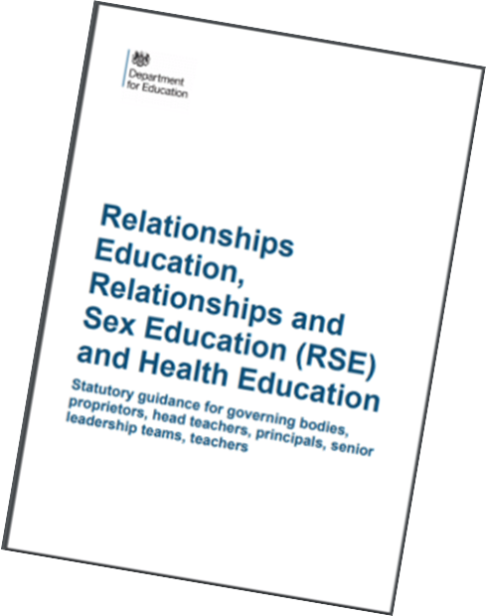
What does the new statutory guidance cover?
Relationships Education
The focus of Relationships Education is on teaching the fundamental building blocks and characteristics of positive relationships with particular reference to friendships, family relationships, and relationships with other children and with adults. The Department for Education guidance requires us to teach objectives under the following topics
• Families and people who care for me
Caring Friendships
Respectful Relationships
Online Relationships
Being Safe
You cannot withdraw your child from Relationships Education because it is important that all children receive this content.

Slide 8
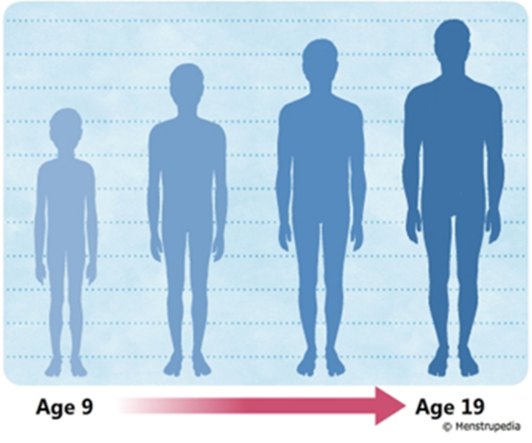
Health Education
The focus of Health Education is on teaching the characteristics of good physical health and mental wellbeing. Elements of our Health Education are timetabled to complement and support the teaching of RSE.
Department for Education guidance requires us to teach objectives under the following topics:
Mental Wellbeing
Internet Safety and Harms
Physical Health and Fitness
Healthy Eating
Drug, Alcohol and Tobacco
Health and Prevention
Basic First Aid
The Changing Adolescent Body
Aspects of Relationships and Sex Education can also be found in the bold font Health Education units

Slide 9
SCIENCE
It is compulsory for all maintained schools to teach the parts of sex education that fall within the Science Curriculum. The statutory content requires maintained schools to teach children about human development, including puberty and reproduction

Slide 10
SCIENCE CURRICULUM
In Key Stage 1, pupils will:
Be introduced to the process of reproduction and growth in animals. They should be introduced to the concepts of reproduction and growth, but not how reproduction occurs.
Key Stage 2, pupils will:
Be taught about different types of reproduction, including sexual and asexual reproduction in plants and sexual reproduction in animals. Pupils should draw a timeline to indicate stages in the growth and development of humans. They should learn about the changes experienced in puberty.

Slide 11
What are the recommendations for Schools?
Introduce children to the correct scientific terms to describe body parts in Key Stage 1
Challenge the use of 'gay' as an insult and include work around the makeup of different families
Explore challenge gender roles/ stereotypes - linked to the Equality Act 2010
Begin to explore puberty changes by the age of 8/9
Deliver RSE in a progressive way across the school
Ensure that children in Year 5 and 6 receive RSE input around puberty so that they are prepared as soon as possible for the onset of puberty.

Slide 12

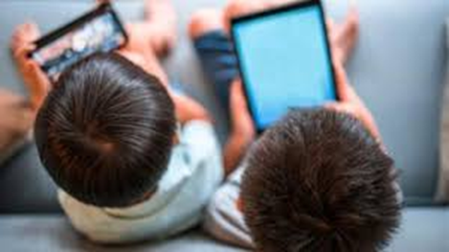
Why is Relationships and Sex Education important?
Safeguarding children is at the heart of Relationships and Sex Education. Children need to know how to protect themselves from:
Abuse
Grooming
Child Sexual Exploitation
Unwanted conceptions
Sexually transmitted infections
Sexting
Online pornography
Puberty is starting earlier- for some children by age 8

Slide 13

Teaching RSE
We follow the Coram Life Education SCARF scheme of work to teach both PSHE and RSE. This scheme of work meets all DfE requirements for statutory Relationships, Sex and Health Education (RSHE). SCARF is a complete curriculum consisting of over 350 lesson plans and related assessments that gives teachers the skills and tools to teach a comprehensive RSHE, PSHE and Wellbeing programme throughout the primary years.
SCARF stands for Safety, Caring, Achievement, Resilience and Friendship. With the idea that a SCARF is something you can wrap around person or a whole school to keep it safe and healthy.
The lessons and resources are designed to be taught from reception through to year 6 providing us the necessary lessons and resources for when we make the transition from a lower school to a primary school.
Further information about our scheme can be found on our website.

Slide 14
Can I withdraw my child from RSE?
From September 2020 Parents and carers only have the right to withdraw their child from non statutory Sex Education outside of the science curriculum. The only sex education content outside the science curriculum is in Year 6.
From September 2020 parents do not have the right to withdraw their child from lessons on Relationships or Health Education or the Science Curriculum.
If a parent or carer wishes to withdraw their child from Sex Education when they are in year 6 we ask that they discuss it with the Head of school or Head teacher in the first instance. A request to withdraw a child from these lessons must be put in writing to the Head teacher following this initial meeting.
Parents, carers and staff should be aware that children who are withdrawn from RSE will have questions about why this has happened. It should also be understood that children may ask their peers questions about lesson content.

Slide 15
What does Relationships Education (RSE) look like across year groups?
The following slides give you an opportunity to see how the programme builds each year, introducing each theme in an age appropriate way.
An additional session will be held to share examples of resources that will be used to support learning.

Slide 16

Reception Class content
Seasons and change
Life stages in plants, animals and humans
Where do babies come from?
Getting bigger
Me and my body
Looking after my special people
Looking after my friends
Sample Learning Activities
Role play how you can help your special people at home
Read a book together about getting bigger
Using the pairs cards, match up the baby animal with its adult equivalent
Invite a midwife in to talk about her job
Draw pictures of a friend. At the bottom of the picture write how they look after that friend or how their friend looks after them.
Notes:
This, and the following slides give a flavour of what is taught in each year group. For further information it would be useful to print out key resources to look at in more detail.

Slide 17
Year 1 content
Extending learning from Reception.
New content includes:
Our special people
Caring behaviour
Respecting others
Safe touch
Unsafe secrets
Friendship
Communication
Bullying
Boundaries
Privacy including naming the genitals
Feelings
Sample Learning Outcomes
Recognise and name some of the qualities that make a person special to them
Identify simple qualities of friendship
Identify things they could do as a baby, a toddler and can do now
Explain the difference between appropriate and inappropriate touch
Identify who they can talk to if they feel uncomfortable about any secret they are told, or told to keep
Identify parts of the body that are private

Slide 18
Year 2 content
Extending learning in year 1.
New content to include:
How my behaviour (positive or negative) affects others
Becoming more independent
Keeping themselves and others safe
Growing from young to old and how people’s needs change
Sample Learning Outcomes
Identify some of the ways that good friends care for each other
Know and use words and phrases that show respect for other people
Explain where someone could get help if they were being upset by someone else’s behaviour
Identify situations in which they would need to say 'Yes', 'No', 'I'll ask', or 'I'll tell', in relation to keeping themselves and others safe.
Identify the types of touch they like and do not like
Explain that our genitals help us make babies when we are older

Slide 19
Year 3 content
Extending learning in year 2.
New content to include:
Change including bereavement
Images in the media
Protecting personal information online
Different types of relationships
Healthy and unhealthy relationships (friendships),
Discrimination and its consequences
Understanding risk
Making informed choices
Resisting pressure
Menstruation
Sample Learning Outcomes
Explain some of the feelings someone might have when they lose something important to them
Recognise and describe appropriate behaviour online as well as offline
Identify when it is appropriate or inappropriate to allow someone into their body space
Recognise who they have positive healthy relationships with
Recognise that repeated name calling is a form of bullying
Understand that for girls, periods are a normal part of puberty

Slide 20
Year 4 content
Extending learning in year 3
New content to include:
Body changes in puberty
Conflicting emotions
Good and not so good feelings
Marriage and other relationships
Consequences of our actions
Recognise and challenge stereotypes
Pressures to behave in an unacceptable, unhealthy or risky way
Sample Learning Outcomes
Understand and explain why puberty happens
Suggest reasons why young people sometimes fall out with their parents
Discuss the reasons why a person would want to be married, or live together, or have a civil ceremony
Define what is meant by 'being responsible‘
Understand and identify stereotypes, including those promoted in the media
Understand that we can be influenced both positively and negatively

Slide 21
Year 5 content
Extending learning in year 4.
New content to include:
Body changes and feelings during puberty
Changing feelings and the effect on those we live with
Unhealthy relationships
Risky behaviour
Using social media safely
Types of bullying including homophobic
Keeping personal information private online
Sample Learning Outcomes
Identify some products that they may need during puberty and why
Recognise some of the feelings associated with feeling excluded or ‘left out’
Identify what things make a relationship unhealthy
Explore and share their views about decision making when faced with a risky situation
Recognise that people aren’t always who they say they are online
Recognise that some people can get bullied because of the way they express their gender
Know how to protect personal information online

Slide 22
Year 6 content
Extending learning in year 5.
New content to include:
Body image
Sharing images online
Forced marriage
Conception, reproduction & birth
HIV
Sample Learning Outcomes
Recognise that photos can be changed to match society's view of perfect
Explore the risks of sharing photos and films of themselves with other people directly or online
Describe ways in which people show their commitment to each other
Know a variety of ways in which the sperm can fertilise the egg to create a baby
Explain how HIV affects the body’s immune system

Slide 23
Next steps
Thank you for taking the time to look at this presentation. We hope that it helps explain the importance of teaching RSE at Primary schools and you feel more informed about how and when things will be taught.
If you have not already done so, please look at our draft PSHE & RSE policy along with the supporting information which we hope you find informative.
Lastly, please take the time to complete our questionnaire so that we receive your views and create a RSE programme of work appropriate to the needs of our children in today’s modern world.

