Slide 1

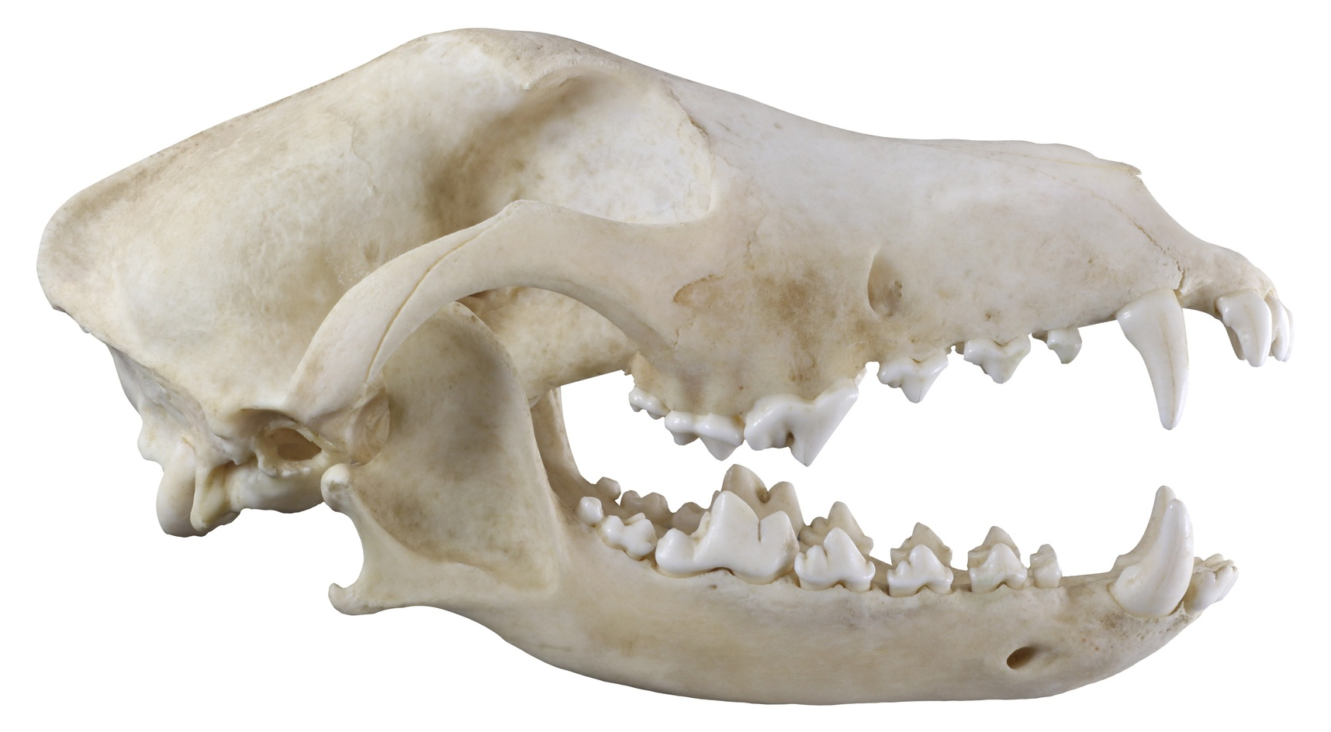
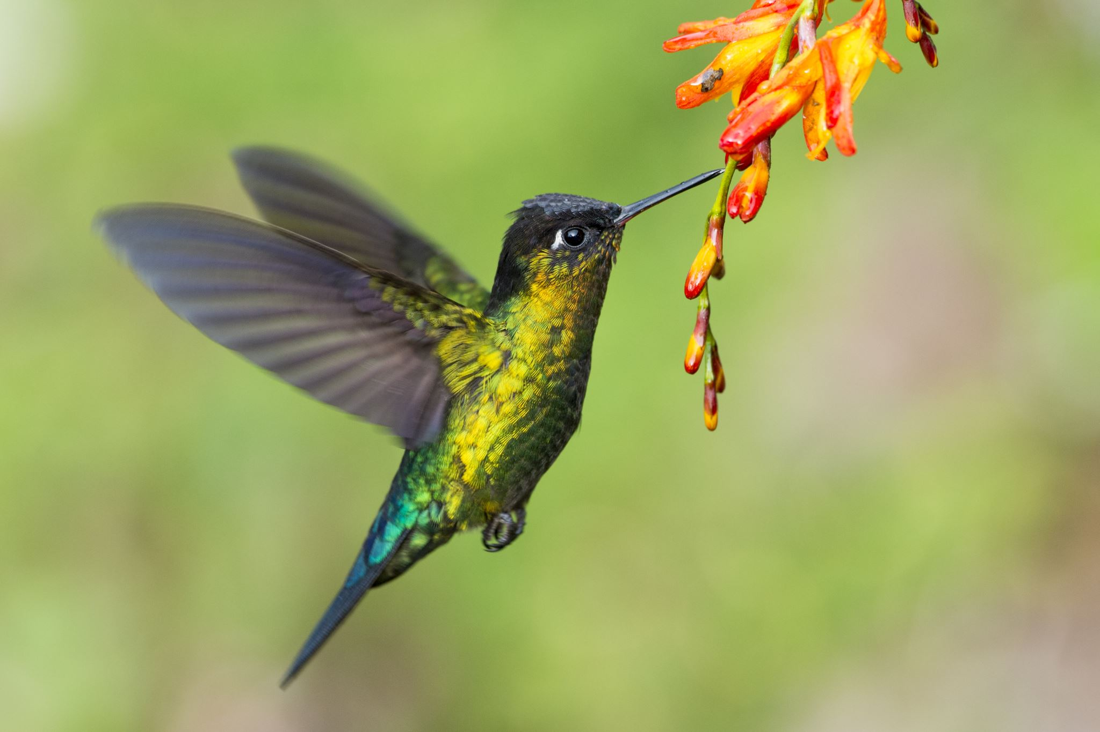
Maths
The units the children will be looking at this half term are place value up to 10,000 and addition and subtraction of 4 digit numbers. We will continue to work on our times table fluency in preparation for the Year 4 multiplication check in June.
Geography
We will be exploring why rainforests are important to us and examining the relationship between climate and biomes by locating the Amazon rainforest and investigating its physical features and vegetation.
.
Year 4
English
The children’s writing will focus on learning about graphic novels and speeches. Our focus texts will be ‘Arthur and the Golden Rope’ by Joe Todd Stanton, and ‘The True Story of the 3 Little Pigs’ by Jon Scieszka.
Science
In the Autumn term children will learn all about the human digestive system, the function of key organs and how is food is processed in the body .

Slide 2
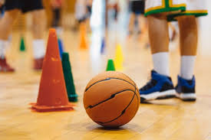

PSHE
The unit the children will be looking at is ‘Me and my relationships’.
Computing
On Scratch, we will be designing and programming a game with variables, sensors and ‘if’ statements to control outcomes and interactions.
Art
The children will continue to develop shading skills and drawing techniques and exploring the use of shadows and highlights.
French
We will be learning about adjectives and how they change depending on what noun they are describing (masculine and feminine).
PE
The children will be learning skills relating to outdoor adventurous activities, such as map reading, and communicating well with others by receiving and giving clear instructions among other things.
Worldviews
We will be exploring the origins of various religions, discovering geographical and historical connections among them whilst asking themselves ‘are all religions and worldviews equal?’
Music
This term, we will be busy learning all our songs for our Young Voices performance in February. We will also be learning some Christmas songs for our Christmas performance at the Church.

